Slide 1
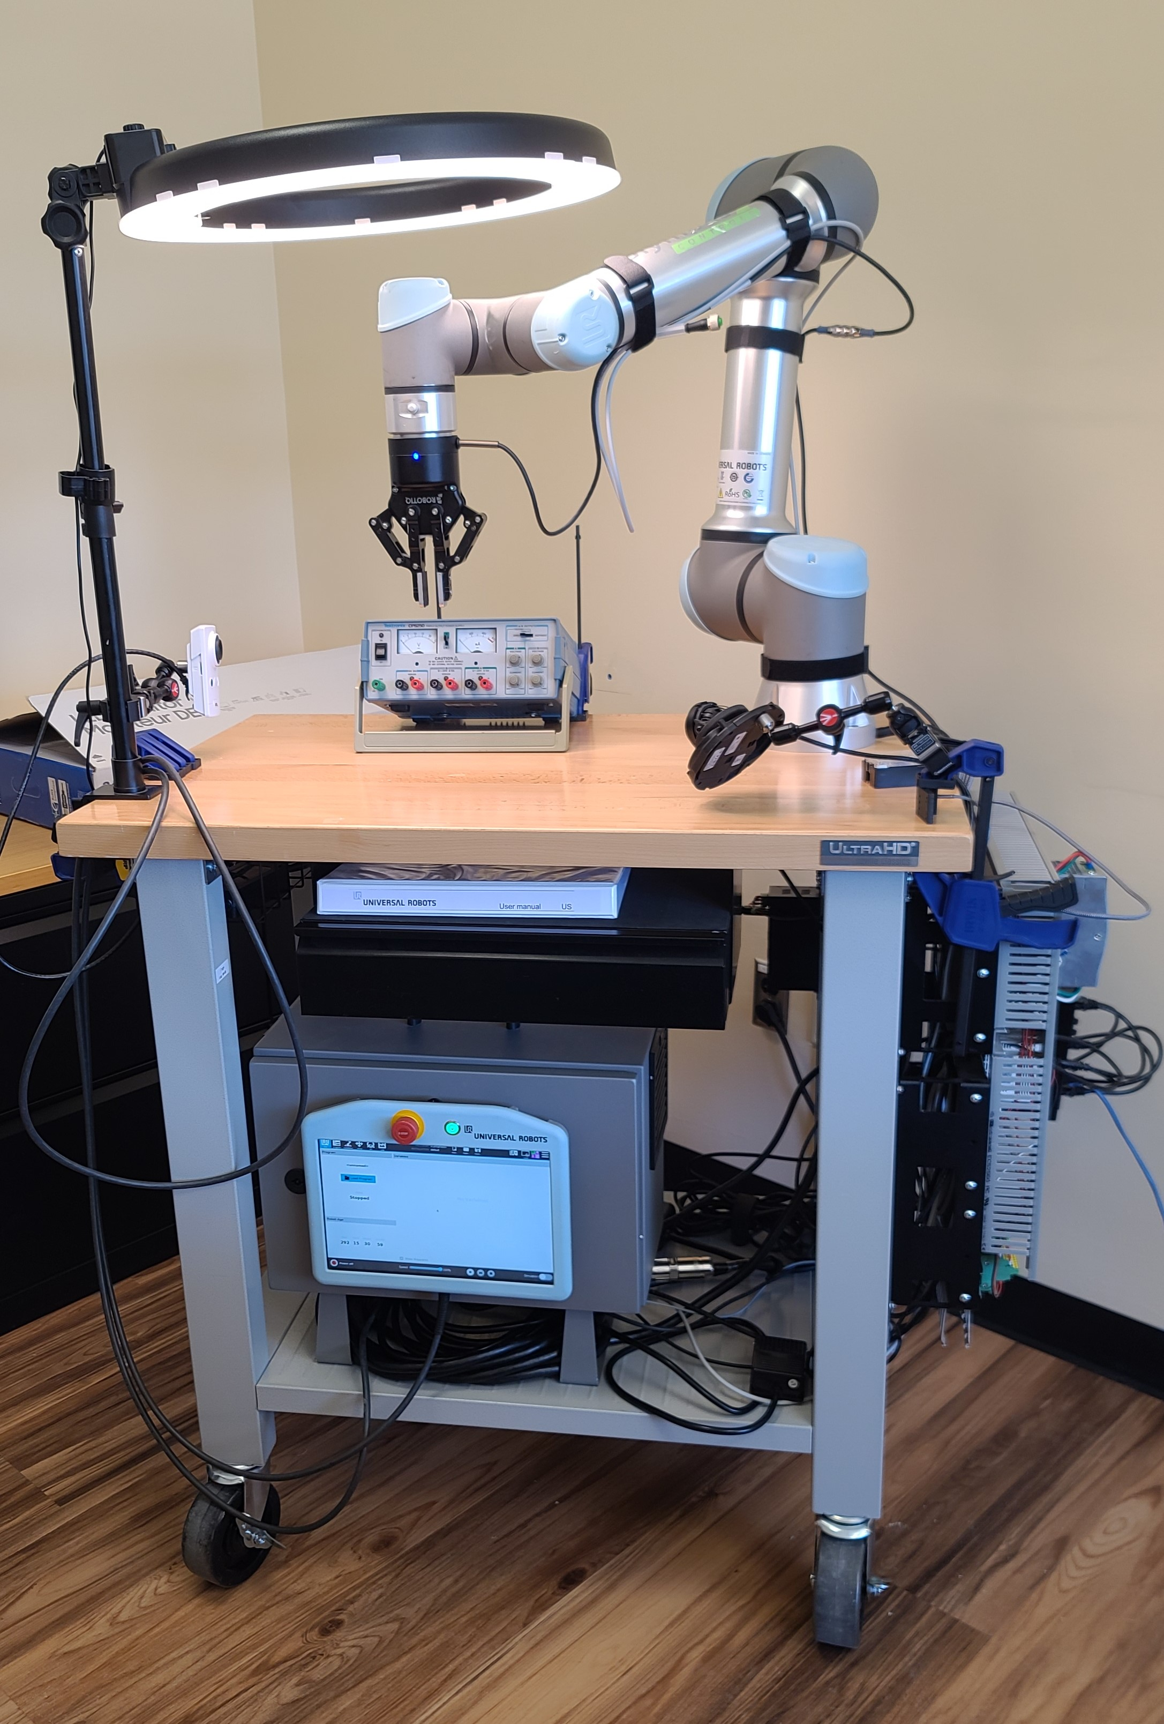

CSC485B Machine Learning for Robotics
SUNY Plattsburgh
Dr. Ned Lecky
Class 06- More Details on the UR

Slide 2
Learnings from Homework1
Grades are on the Moodle
Feedback
A few of you didn’t address the assignment and so got no grade
Feel free to resubmit for no penalty (this time!)
Formatting
Please put your name in the top cell and include it in the filename
E.g. CSC485B_HW1_NedLecky.ipynb
Use Text and Code cells in your Colab to describe what you’re doing
Your code must run EASILY- if you use data files, they need to be included!
Attaching your submissions to the Moodle assignment seems less chaotic and it’s easy for me to download and then run it locally
Also, there’s a record and a snapshot in case you go edit your old Colab!!

Slide 3
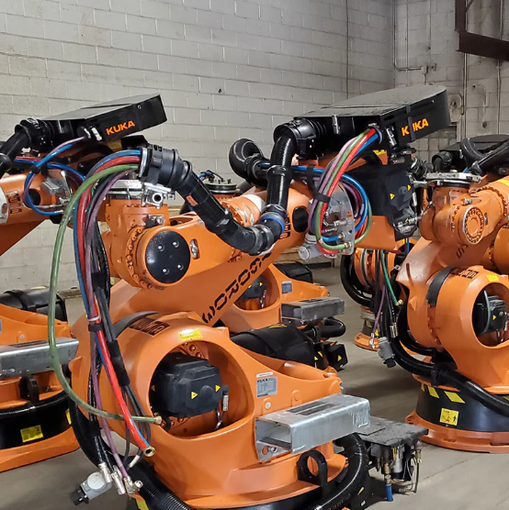
Other Things Worth Showing
IO
A look in the cabinet
And always remember your Dress Pack!
85% of all robot failures
Screwdriving/tool changing
https://www.youtube.com/watch?v=RXmB1aAQLWY
https://www.youtube.com/watch?v=ESITp_bXorg

Slide 4
A Different Example
Let’s try pick-and-place
With re-orienting a simple part?
Kinda hard, right?? Why?
Robot motion limitations
Gripper motion limitations
Gripper/part size factors
Lots of assumptions….
Where is the part?
How is the part oriented?
How big is the table?
Is there anything else in the way? Collision concerns?
Our solution is “fragile”
Small things changing would totally break our program!

Slide 5
A System Integration Platform…
We need an integration platform to simplify coding
The robot programming language really only controls the robot
We will want to programmatically move the robot AND
Talk to image processing systems
\Talk to other sensors
Create data files that we can use for training
LEonard: My own product, so FREE! (For us!)
Currently in use for semiconductor glass polishing applications in Portland
Also in use for fighter jet assembly research
Advantage for us- free, and I can hack it any way we like since I wrote it!
Crucially:
Gives us a way to programmatically move the robot around using Python without needing to know too much about LEonard!
DEMO

